Slide 1
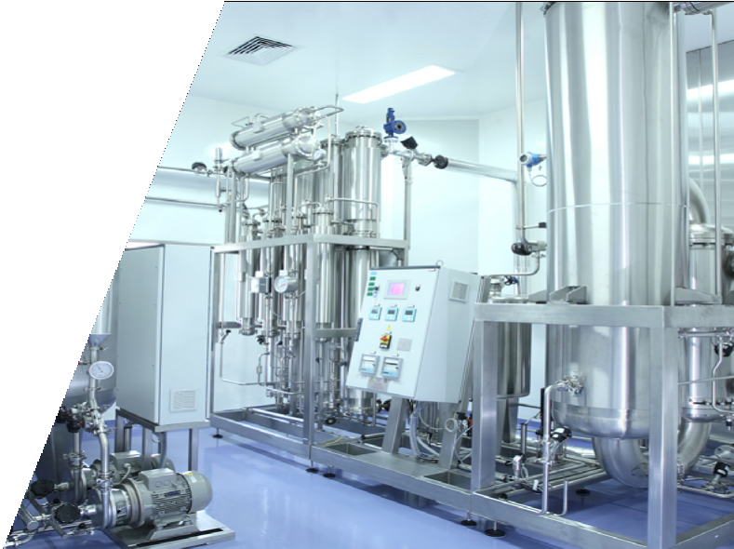


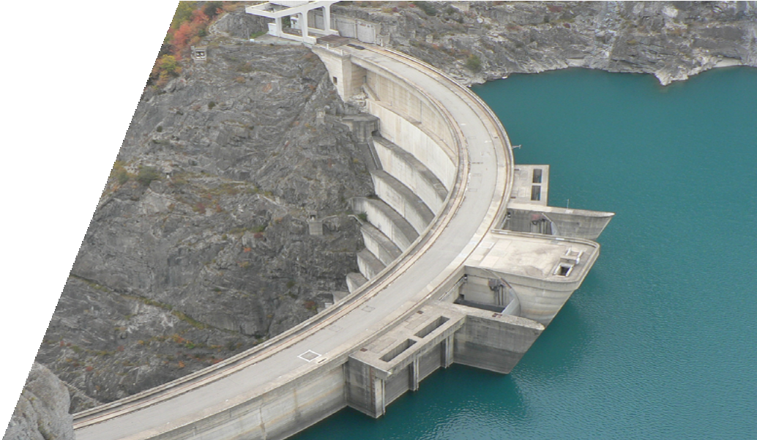
IPI GROUP
The fluid transfer expert
Pumps • Fittings• Valves • Machining

Slide 2




IPI Group: Key Figures
Turnover
~ 45 million euros
IPI GROUP
The fluid transfer expert
Hydraulic industry needs specific competencies.
IPI Group is made up of international companies, recognized experts in the hydraulic industry.
Due to its four divisions, Pumps, Fittings, Valves and Machining, IPI Group responds to the needs of its customers with a global reliable and responsive offer.
270
employees
Exportation 45%
Large range of hydraulic products and brands

Slide 3










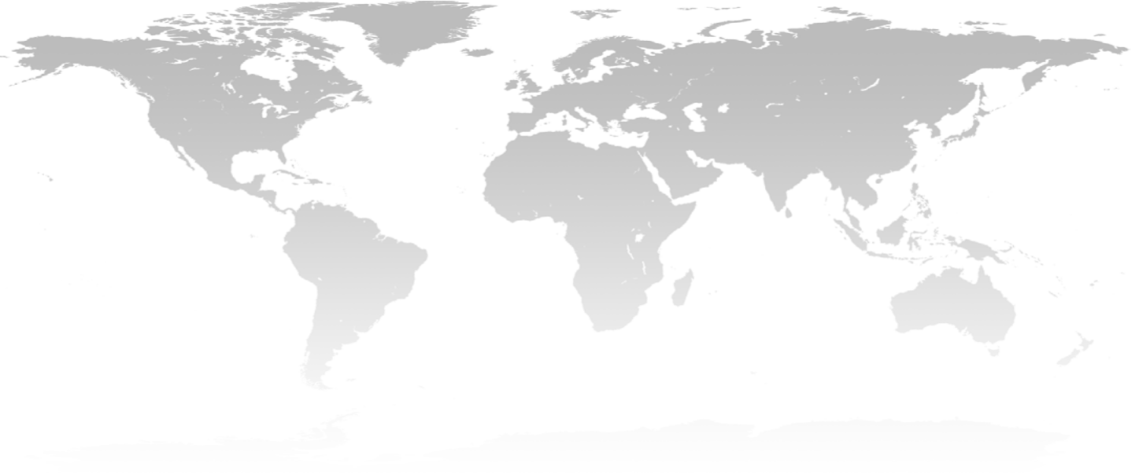










IPI Group: Established Internationally

Slide 4










IPI Group: 4 Divisions
PUMPS
DIVISION
FITTINGS
DIVISION
VALVES
DIVISION
MACHINING
DIVISION

Slide 5
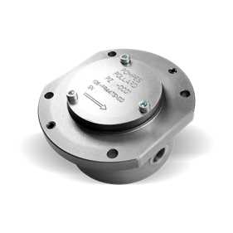

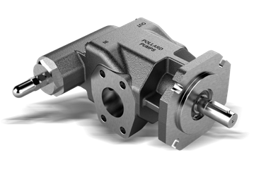

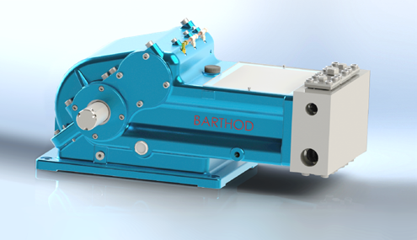

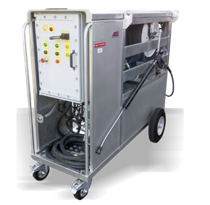
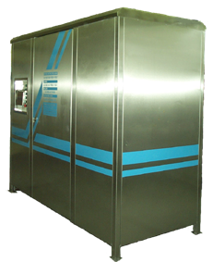
IPI Group: Pumps Division
Pollard 189 Avenue de Copenhague Parc d’activités de Signes 83870 Signes FRANCE +33 (0)4 94 10 19 90 contact@pompes-pollard.com www.pompes-pollard.com
Activity Design and manufacturing of positive displacement pumps and motorpumps
Established 1941
Joined the Group 1997
Barthod 5 Avenue Lionel Terray 69330 Meyzieu FRANCE T +33 (0)4 72 97 07 10 contact@barthod-pompes.com www.barthod-pompes.com
Activity Design and assembly and distribution of high pressure pumps, motorpumps, washing head and skids
Established 1929
Joined the Group 2009
Hydro-France 12 route de Lembeye 64350 Peyrelongue FRANCE T +33(0)5 59 68 11 43
Activity Design and manufacturing of high pressure cleaners and car wash stations
Established 1981
Joined the Group 2017
contact@hydrofrance.fr www.hydrofrance.fr

Slide 6
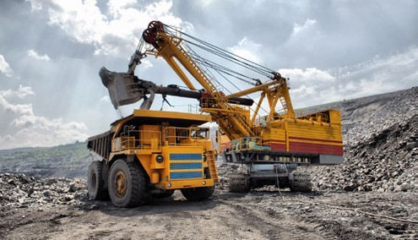

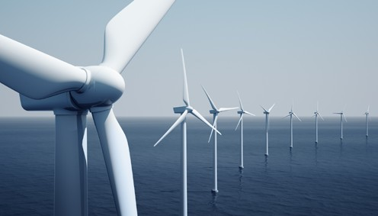

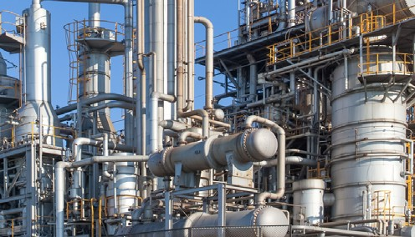
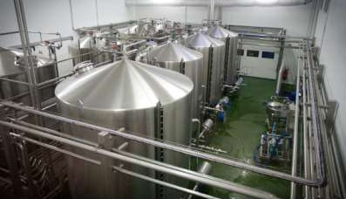
IPI Group: Pumps Division - Industries
Transport (Diesel transfer)
Agricultural machinery
Power transmission (wind power)
Railway
Nuclear
Mining
Oil & Petrochemicals
Lubrication
Textile industry
Industrial cleaning
Building and Public Works
Hydraulic engineering
Industrial processes & Machining

Slide 7







































IPI Group: Pumps Division - Clients
France | Worldwide

Slide 8
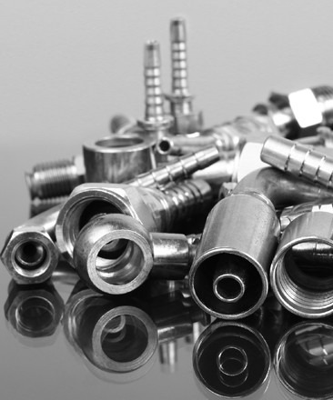


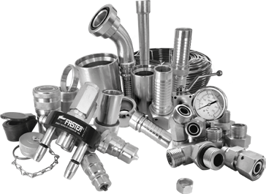
IPI Group: Fittings Division
DMH France 6 rue Jupiter 44470 Carquefou FRANCE T +33 (0)2 40 25 77 27 contact@dmhfrance.com ww.dmhfrance.com
Activity Distribution of hydraulic fittings
Location Nantes and Lyon (FRANCE)
Established 2004
Joined the Group 2012
PRODUCTS RANGE:
Valves
Hoses
DIN fittings
Clamps
Components
Flanges
JIC fittings
Pressure
Hose fittings
Protection
ORFS fitting
Cleaning
GAZ fittings
BSPP fittings
Seals
LinkFluid Unit 37, Hughes industrial park, 422 Oscar Road CNR of Romeo Street, Boksburg, 1459 Gauteng, SOUTH AFRICA T +27 (0)11 823 1343 info@linkfluid.co.za www.linkfluid.com
Activity Distribution of hydraulic equipment; Accent on the IPI Group brands
Location South Africa, Switzerland, Germany
Established 2014
Joined the Group 2014

Slide 9

















IPI Group: Fittings Division - Clients

Slide 10

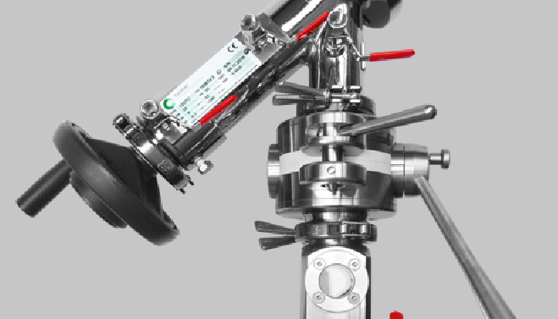
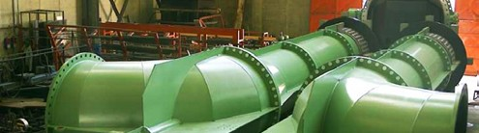


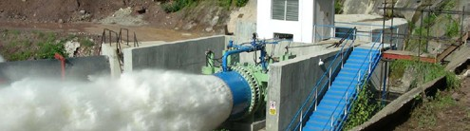
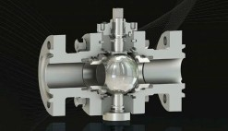

IPI Group: Valves Division
Activity Design and manufacturing of sampling, tank, charging valves
Established 1974
Joined the Group 2016
FAMAT
Rue des Jordils 40 CH - 1025 St-Sulpice SWITZERLAND
T +41 21 695 26 26
info@famat.com www.famat.com
Activity Design and manufacturing of waterworks valves: Large diameter valves in specific materials; Valves for water distribution systems and for dams
Established 1967
Joined the Group 2016
Nencini
Località Belvedere, Ingresso 6 53034 – Colle di Val d’Elsa (SI) ITALY
T +39 0577 930880
nencini@nencini.com www.nencini.com
Darco Rue du Pont Long, 64160 Morlaàs, FRANCE T +33 (0)5 59 84 63 00 info@darco-valves.com
Activity Design and manufacturing of a large range of manual and/ or actuated ball valves
Established 1998
Joined the Group 2018
www.darco-valves.com

Slide 11
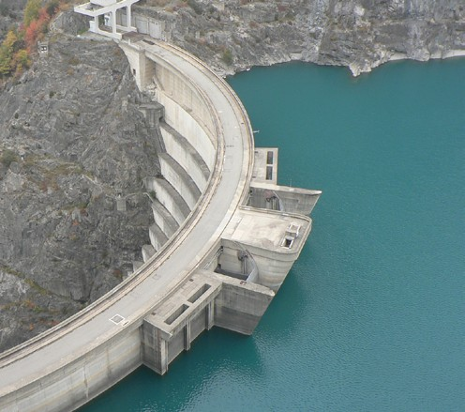
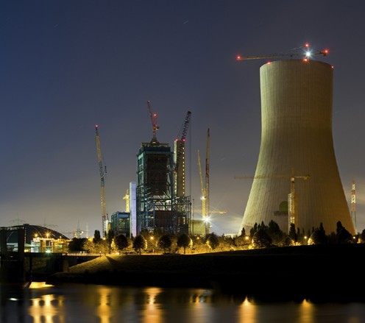
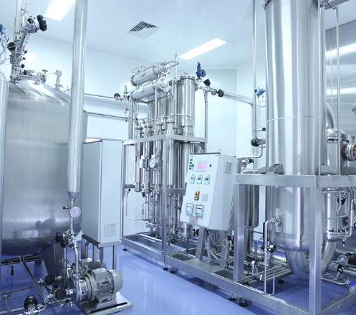
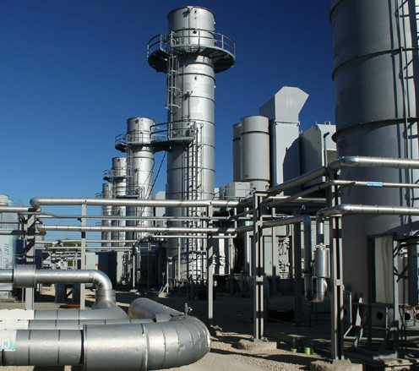
IPI Group: Valves Division - Industries
FAMAT :
Water distribution systems
Power generation
Petrochemicals
Oil & Gas
Pharmaceutical, chemical
Cosmetics & Food
Nencini :
Power generation
Oil industry
Gas
Petrochemicals
Darco :
Gas
Transport and storage
Crude oil
Corrosive and abrasive flow
Sour services
Chemical services

Slide 12
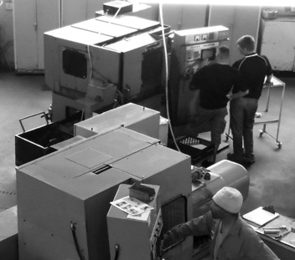

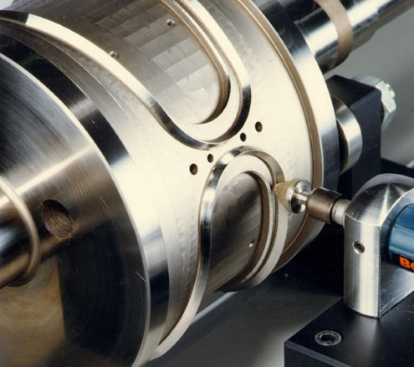

IPI Group: Machining Division
HARGRAM 20 Knights Road Germiston SOUTH AFRICA +27 (0)11 828 9623/9624 info@hargram.co.za www.hargram-engineering.co.za
Activity Precision machining
Established 1951
Joined the Group 2013
Usimetal ZAC du Plan 101 Avenue de la Counoise 84320 Entraigues sur la Sorgue FRANCE +33 (0)4 32 40 00 20 usi.metal@usimetalfrance.com www.usimetalfrance.com
Activity Precision machining, turning, milling (3, 4 and 5 axes) and grinding (internal and external), as well as precision wire EDM, from a single piece to medium scale series.
Established 1998
Joined the Group 2015

Slide 13
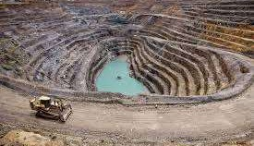
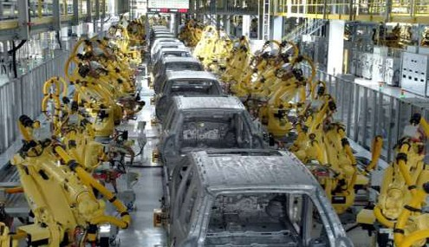
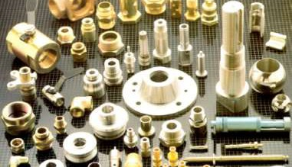
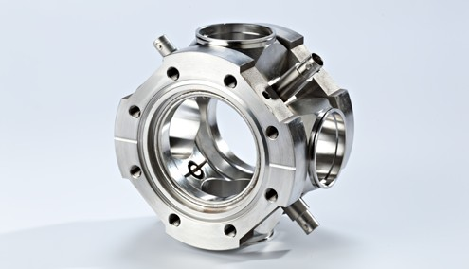
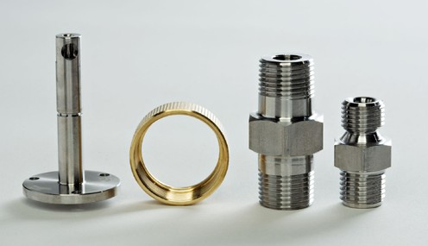
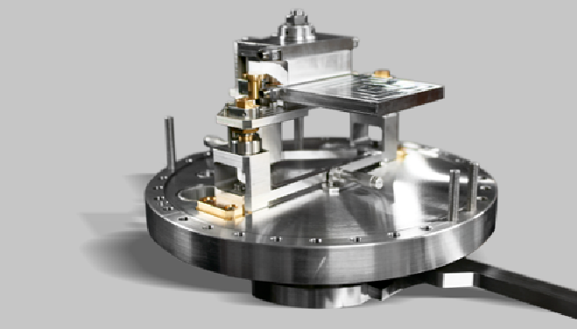
IPI Group: Machining Division - Products & Industries
HARGRAM :
Mining & mineral-related activities;
Automobile industry (Faurecia, Bosch, Ford) ;
Hydraulics (Parker, Hydraulic component, IPI Group, etc.) ;
Chemical ;
Security equipment.
Usimetal :
Rolls, anvils, blades and counter- blades. Work on quenched steel and sizing down to the micron.
Extremely fine parts; implemen- tation of complex machining techniques involving precision continuous multi-axis ma- chining.
Electron Discharge (for Aerospace, Nuclear, Hydraulic, Hygiene, Rotary cutting, Oil drilling industries).

Slide 14









IPI Group: Strenghts
Industrial group manufacturing international quality standards products for various applications
Diversified portfolio with main
international clients
4 Divisions in synergy with the complete cycle of fluid transfer
Producers and / or Distributors of a wide variety of hydraulic components
Several decades of experience conferring great industrial know-how
IPI Group international development
Group controlled by the CEO (Sylvain Loze) and the main managers
Shareholding controlled by the CEO / founder and the management team giving the
financial capacity to the Group
Expected growth ambition to become an SME while maintaining our historical responsiveness

Slide 15
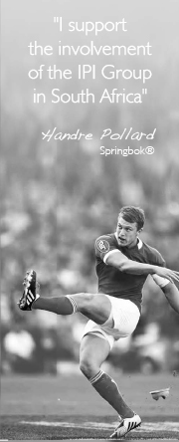
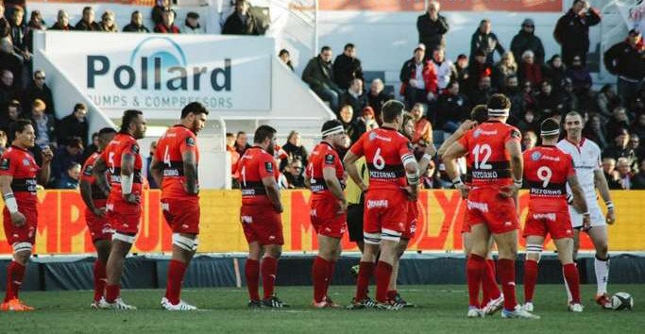

IPI Group: Sports & Culture Sponsorhips
Handre Pollard (South African rugby player, Springboks)
Pollard Pumps, sponsor of Toulon Rugby Club (RCT)
DMH France, long-term partner of La Machine (theater
company, Nantes)

Slide 16


IPI Group: Contact
Groupe IPI
189 avenue de Copenhague Parc d’activités de Signes 83870 Signes
FRANCE
T +33 (0)4 94 10 19 90
F +33 (0)4 94 10 19 99
info@group-ipi.com
www.group-ipi.com

